Slide 1
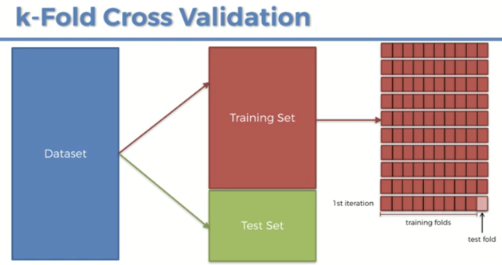
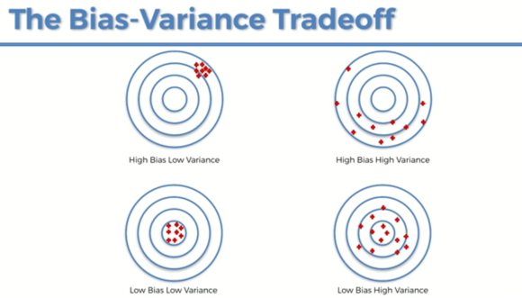
Model Selection (k-cross validation)
MODEL SELECTION
In this section we will do 2 things
Evaluate model performance
Improving model performance
This consist of choosing the best parameters in our model selection problem. This will impact:
1. Those parameters that the model learn and found optimal values by running the model
2. Hyperparameters: The parameter that we chose ourselves to improve the performance of our model (for example, the kernel parameter in the kernel SVM). In this case the technique used is called Grid Search
So far we have evaluated the performance of our models in the test set after the dataset being trained in the training set, but this have the problem of the variance.
The variance problem emerge when we get the accuracy on the test set and then we evaluate the performance in another test set we can obtain a very different result due to the differences in variance between both.
BIAS-ACCURACY TRADEOFF
The K-FOLD validation can help to solve this variance problem by splitting the training set into 10 fold and train the data in 9 folds and then test it in one fold.
By applying this model performance method we will also be able to identify which is the bias-variance trade-off, as displayed in the image.
That is related to the different types of accuracy and variance our data may have. Low accuracy is inverse to high bias and vice versa

Slide 2
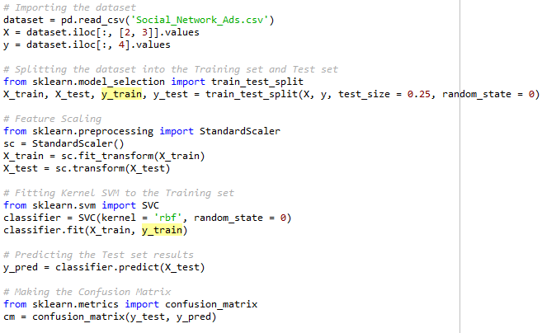

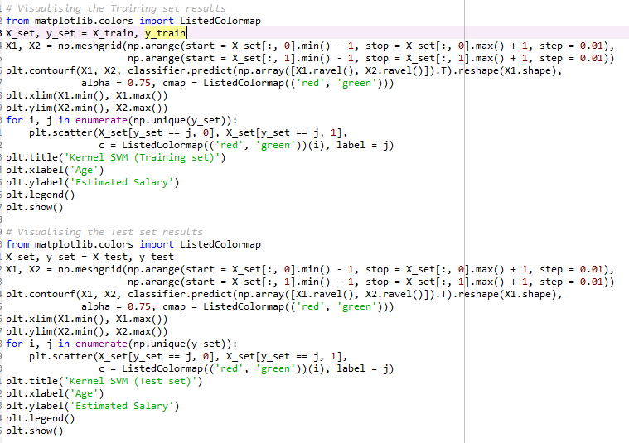
K-CROSS VALIDATION
We are going to use the Kernel SVM we use in the corresponding section to measure the performance through this method. For that we add a new section
For that we import the CrossVal class from the ski learnt python library. As we can see the model will return 1o different accuracies for each one of the 10 combinations. Each one of these 10 combinations is formed of 9 sets to train the model and 1 to test it.
First thing we have to do is define a vector to store each one of these accuracies that we just mentioned.
Secondly, we apply the k-cross function. The parameters it uses are:
- estimator: in this case we will use classifier as that correspond to our model
- X: that would be our training dataset that will be split in a number of folders. It is X_train
- y: this is the dependent variable vector y_train
- groups (that is for scoring and is not important here)
- cb : that is the number of folders we are going to use. A good number is 10 but can be change if we want
Once executed we can see the result in the accuracy vector we created. The first and third accuracy are 80% for example, but the second accuracy is 96%.
What we will do now is obtain the average of all the accuracies we have in our vector and that will give us a better idea on the actual accuracy of our
model.
Finally, we can also obtain the standard deviation from our mean recently calculated, to obtain a better measure of the spread of the data with respect to the mean. In this case it is a 6% of Standard Deviation, which is not too high, so the performance is good so the category would be low bias low variance.

Slide 3
Model Selection (grid search)
Grid search will help us to respond to these two questions:
1. chose the parameters that optimize our model more (or which are the optimal parameters to chose).
2. What model should I chose to solve my problem
For that second question, obviously, we first need to preclassify the problem at high level (if is a classification, regression, clustering etc. problem).
At very high level this logic would be:
Step1. Have dependent variable?
YES
if is CONTINOUS outcome then is a regression
if is CATEGORICAL outcome then is a classification
NO: Clustering
Step2. Is the model linear or not?. Can the data be linearly separable?.
This last question can be responded by Grid Search that, for example, can help us to chose between a linear model as SVM and a non linear model like kernel SVM.
More details on GridSearch
http://scikit-learn.org/stable/modules/generated/sklearn.model_selection.GridSearchCV.html
http://scikit-learn.org/stable/modules/grid_search.html#grid-search

Slide 4
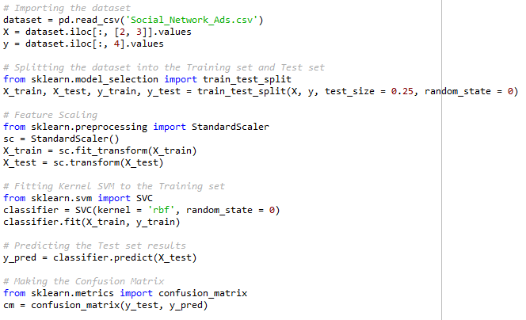
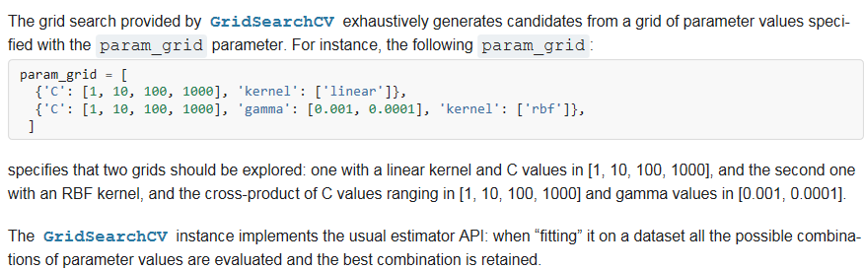
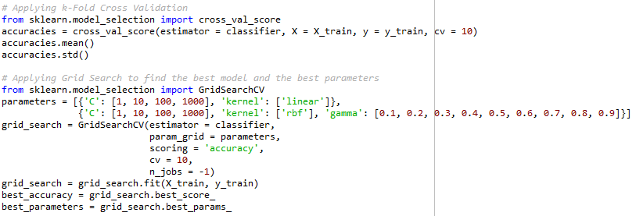
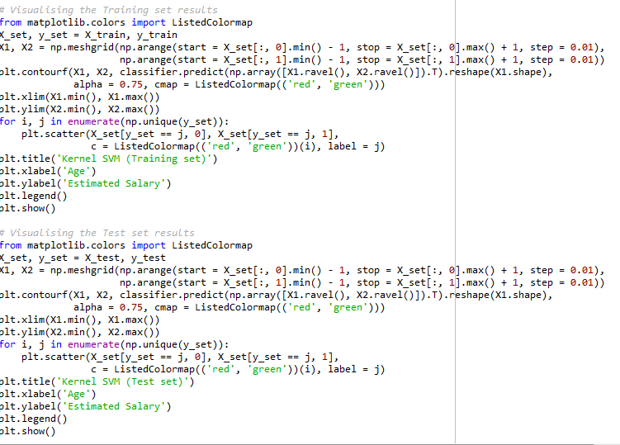
Grid Search
Grid search can be applied after fitting the model to the training set, but in this particular case we will apply after K-Cross validation since that one
works in the evaluation of our model performance and grid search works to improve the model performance.
The package we use for this model is the grid search cb and we import it from sklearn.modelselection library.
Next we specify the different parameters we will use for our model to improve performance as follow:
1. The identifier is the parameter we want to optimize
2. Degree: this is for a polynomial learner kernel so if we do not have it do not need to use
3. Gamma: will help us to find the optimal kernel for our model and also the best penalty parameter to avoid overfitting
What we are going to do in this problem is implement our gridsearch algorithm with two different options for our hyperparameters: one for linear kernel and other one for rbf (which is non linear)
Estimator because the problem is a ‘classification’
Parameters = hyperparameters (that just tuned)
Scoring is the way we will evaluate our model: ‘accuracy’)
Cv is cross validation (number of folds to validate our model as in kcrossvalidation)
N_jobs = -1 for large datasets
Finally, the best_score_ and best_params_ attributes return the values of the model we should chose. In addition, the returned value is not only one value, but an average calculated from 10 different models.
The model that performs better is ‘rbf’ and the parameter value is around 0.1, so we might want to try with other parameters around 0.1, to enhance the performance even more
The response to our problem will tell us:
If our model is linear or non linear depending on which of both kernels returns better results
The best value to chose for the parameter C, which is the penalty parameter to prevent overfitting
The best kernel value to chose

